Slide 1

ANNUAL REPORT
2023-2024

Slide 2
INTRODUCTION:
Syed Foundation is registered trust which has approval of a Non-Profit Organization with Income Tax Authorities u/s 2(36) of the Income Tax Ordinance, 2001. It also registered in FBR as a nonprofit organization and the license is renewed every year. It is working on Donations, Sadqat, Zakat and Lilah. Since its formation, in 2017, it has tried to improve the conditions of people by participating in different socio-economic activities and create a positive impact on communities.

Slide 3
VISION:
A world where every individual, lives with dignity, free from hunger, and fully enjoys their basic human rights in a socially and economically sustainable society.
MISSION:
To empower and uplift vulnerable communities by providing targeted relief and sustainable development solutions, fostering partnerships that enhance self-reliance and uphold human dignity.
OBJECTIVE:
Organize hunger elimination projects, assist students to get education by awarding them scholarships, extend support at time of natural disasters, assist deserving people by providing goods according to the need and provide health facilities.

Slide 4
ACHIEVEMENTS
OF
SYED FOUNDATION:

Slide 5

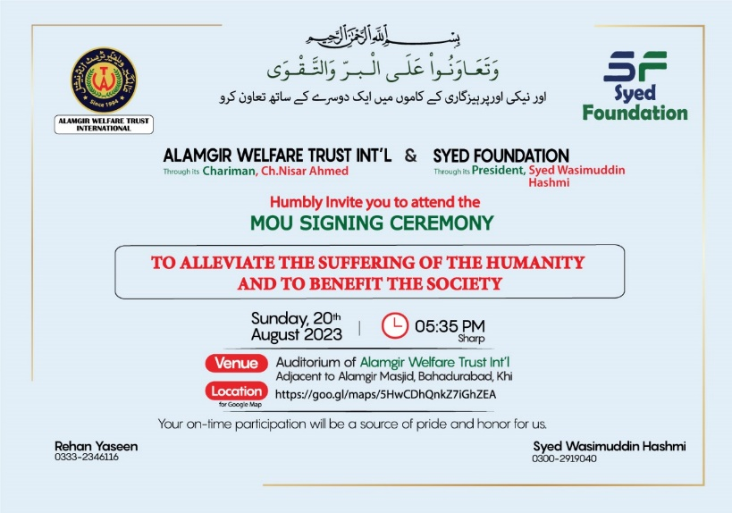
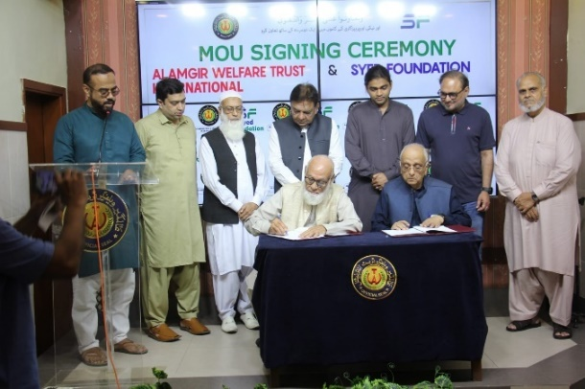
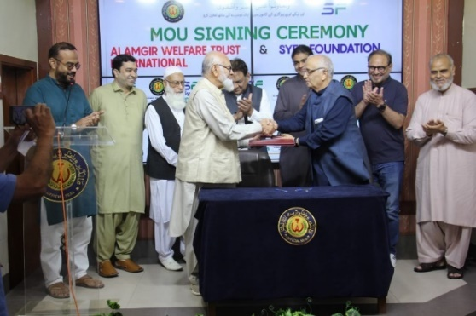
MOU SIGNING WITH ALAMGIR WELFARE TRUST INTERNATIONAL:
The MoU was signed by Chaudhary Nisar Ahmed, Chairman Alamgir Welfare Trust International and Mr. Wasim Hashmi, President Syed Foundation, at a ceremony held in auditorium of Alamgir Welfare Trust International. Eminent speakers addressed the audience.
With SF and AWIT working hand in hand, utilizing all their abilities under guiding personalities and leadership will string them together into a beautiful necklace of service.

Slide 6

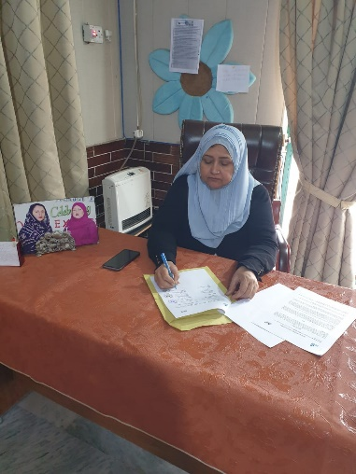
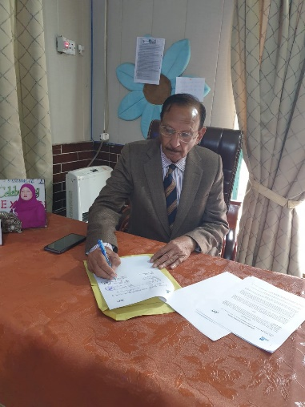
MOU WITH AABROO EDUCATIONAL WELFARE ORGANIZATION:
Signed Memorandum of Understanding (MOU) with reputable NGO, Aabroo Educational Welfare Organization located in Lahore, Pakistan. Aabroo Educational Welfare Organization started in January 2003. It was registered in Lahore, under the “Voluntary Social Welfare Agencies Ordinance (XLVI of 1961)” in August 2003.

Slide 7

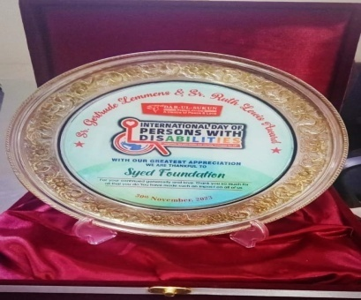
APPRECIATION AWARD OF SR. GERTRUDE LEMMENS & SR. RUTH LEWIS:
On the occasion of International Day of Persons with Disabilities, Syed foundation has been honored with Appreciation Award of Sr. Gertrude Lemmens & Sr. Ruth Lewis by Darul Sukun Welfare Society, recognizing the organization’s unwavering commitment and outstanding contributions.

Slide 8
ACTIVITIES
OF
SYED FOUNDATION:

Slide 9

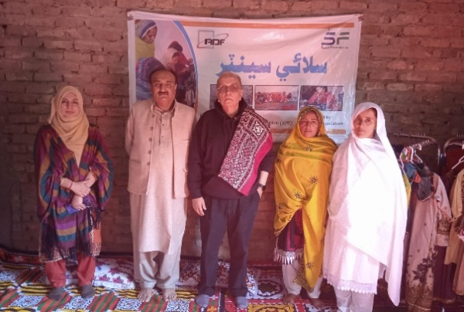
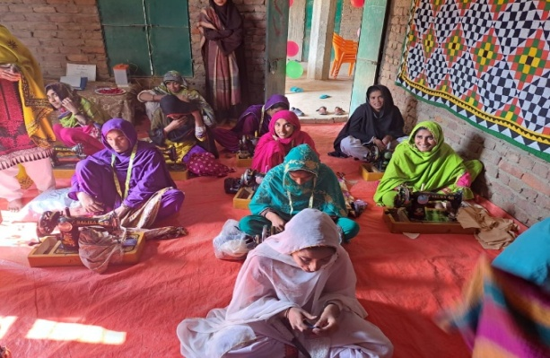

EDUCATION SCHOLARSHIPS:
Provided admission and semester fees totaling to around Rs.1,157,600/- to deserving university students.
Extended school scholarships to 66 students across various schools.
To empower economically disadvantaged women we covered the fees Rs. 12,500/- of all 30 ladies , so all the ladies learn at the Stitching Centre in Malook Khan, a village near Tando Allahyar.
Given fund of Rs.49,000/- to provide support to five students with new books and uniforms through our year-round scholarship program. Furthermore donated Rs.100,000/- to Alamgir Welfare Trust International Education Program.
“Education is the most powerful weapon which you can use to change the world.”-Nelson Mandela

Slide 10

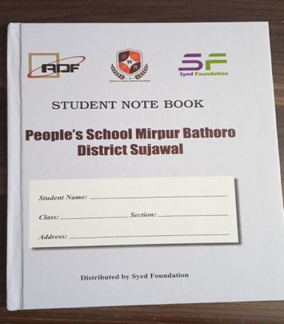
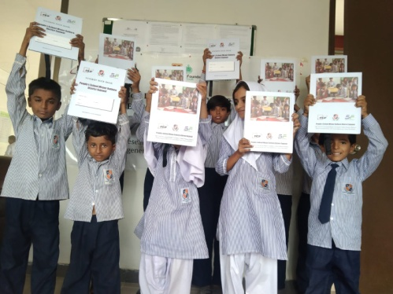
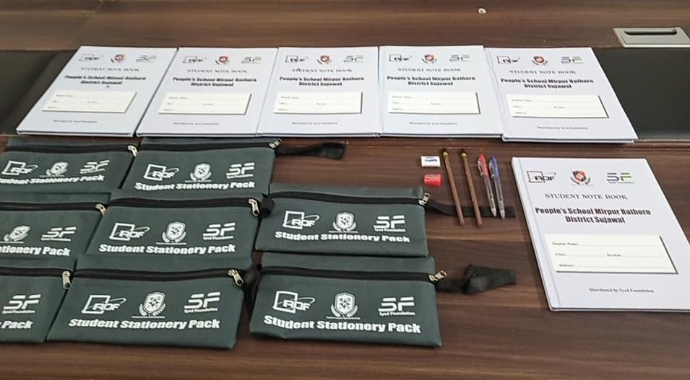
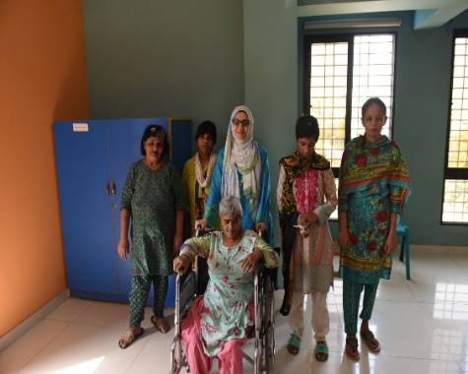
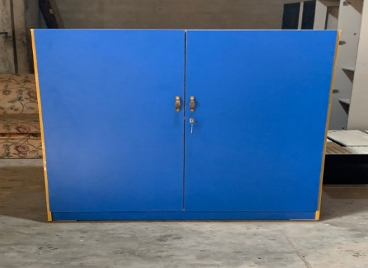
Stationary packs and registers, having worth of Rs. 250,000/- were distributed among students of SMIU School Karachi and Peoples School MirpurKhas and Sujawal.
Three cupboards were given for the classes of special children in the Rehabilitation Centre of Darul Sukun.
  Contributed Rs.10,000/- towards the book publication promoting literature.

Slide 11


MEDICAL ASSISTANCE:
Provided a financial aid of Rs.300,000/- in the past twelve months to Omair Sana Welfare Foundation.
For the treatment of an especially able girl at Islamic Medical Center, Rawalpindi, Syed Foundation has provided a financial aid of Rs.300,000/- during the past six months.
Contributed in providing a hospital bed to a bed-ridden patient.
SF has extended vital financial support, allocating a total amount of Rs.445,345/-to aid various patients in covering expenses for essential medicines and crucial lab tests.
Financial support of Rs.50,000/- was given to a patient for his essential surgery at Bantva Anis Hospital.
Donated Rs.20,000/- towards the patient’s operation at Jamal Noor Hospital.
Generously donated Rs. 111,000/- towards the patient’s bone marrow transplant operation.
70F Friends of Humanity collaborated with Syed Foundation, and made a donation of Rs. 280,000/- for the operation of a boy at Liaquat National Hospital.
Provided medicines and injections worth Rs.200,000/- for an elderly patient residing at DarulSukun Old House.
Contributed Rs.150,000/- towards the critical operation of an infant child at M.Hashim Memorial Trust Hospital.
“We know only too well that what we are doing is nothing more than a drop in the ocean. But if the drop were not there, the ocean would be missing something.”
-Mother Teresa

Slide 12

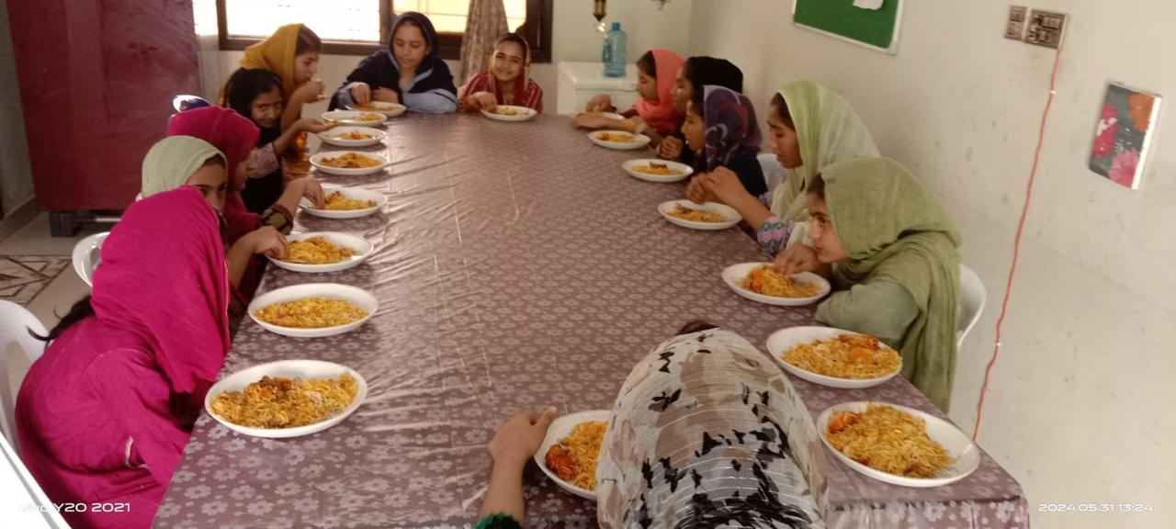
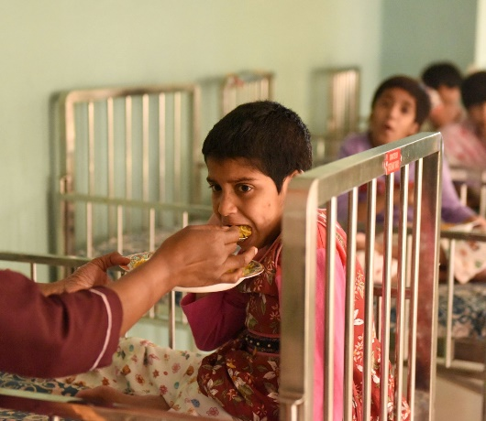
FOOD DRIVES:
“There is nothing greater than love invested in helping to feed the impoverished living in hunger.” ― Wayne Chirisa
Conducted food drives at institutions such as DarulSukun center for old people, Darul Sukun centre for disable children, Idarieu School for Blind and Deaf, Aashiyana House old home for women and orphanage Al-Furqan Homes worth of Rs. 2,015,000/- feeding around 10,300 people.
Provided 50 packets of biryani of worth Rs.11,000/- at an event on 24th November at Liyari, Karachi.
Lunch was arranged in Mehran town in January, courtesy by Mr.S.M.Mohsin and family.
In January Lunch and refreshments were arranged at KMC Sports Complex for the players from Baluchistan.
Provided lunch for 75 people at the final ceremony of Blind Sports Function in May.
Provided lunch for 100 people of worth Rs.25,000/- at the final ceremony at KPT Stadium in May.
Provided refreshment boxes for 35 people of worth Rs.7,000/- at AraamBagh in May.

Slide 13

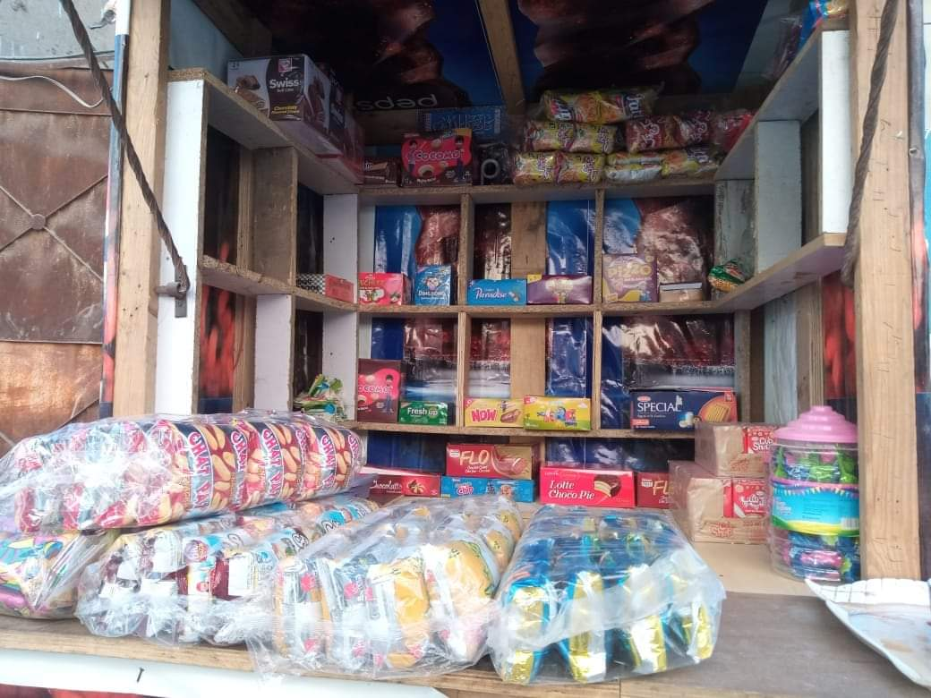
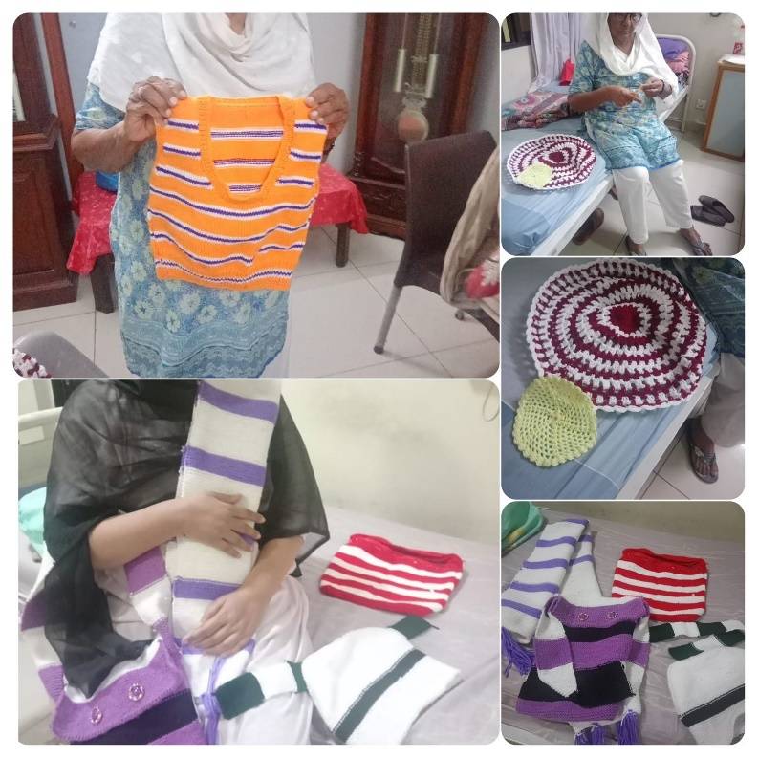
FINANCIAL ASSISTANCE:
Provided consistent financial assistance to 9 families each month during this year, with a total cumulative worth of Rs. 876,000/-.
In our project of Marriage Assistance, Rs. 162,000/- donation was given to needy families. Provided a ceiling fan as part of our marriage assistance program.
Contributed Rs. 39,750/- for construction of roof of house for poverty-stricken families.
Covered the NADRA fee of Rs. 22,000/- for a cleaner, easing a financial burden and ensuring access to essential documentation.
Contributed wool, needles, and frames to both an elderly care facility Darul Sukun Old House Karachi and the Stitching Centre at Tando Allahyar.
Financial aid of Rs. 40,000/- was given to support 3 needy families.
In response to the sweltering summer conditions, extended support to a needy family by providing them with a standing fan.
Made a meaningful contribution of Rs.25 000/- to help a needy family establish a French Fries Cart. Also contributed Rs. 10,000/- with Khas Foundation to setup a confectionary cart for a needy individual.
“No one has ever become poor from giving.” – Anne Frank.

Slide 14

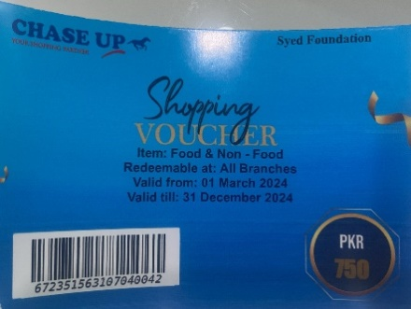
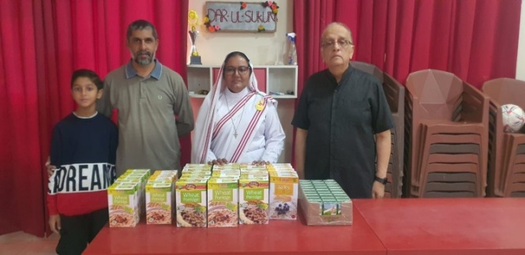
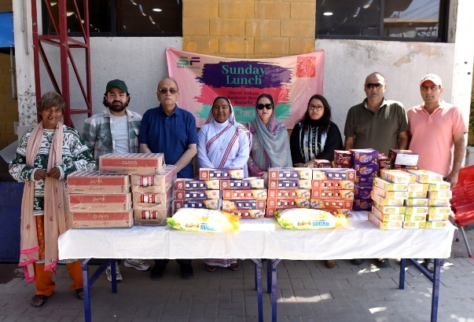
GROCERY DISTRIBUTION:
Ration bags worth Rs. 3,474,887/- were distributed among 61 families every month.
Monthly Chase grocery vouchers were distributed among 42 Families having the total worth of Rs. 256,000/-.
Contributed Rs. 5,000/- in Inflation Relief Program with Khas
Foundation to distribute flour.
Contributed Rs. 30,000/- for Porridge and Cerelac for children and senior citizens residing at Darul Sukun throughout the year. Moreover gave some eatables including 20 dozen eggs, 20 porridge boxes, 10 cartons of milk, 20 boxes of biscuits and 10 kg sugar for them.
Received a generous in-kind donation of 150 Packets of tea of worth Rs.135,000/- and distributed among needy individuals and different institutes including Ehsas-e-Insaniyat, Darulsukun Old House, Aashiyana Trust, KSF , Sweet Home and Stitching Centre Tando Allahyar.
"Feeding the hungry is not just a charitable act; it is a profound expression of our shared humanity and a commitment to building a world where no one goes to bed hungry."-Unknown

Slide 15

Donated 10kg flour to support the humanitarian efforts of NGO Ehsas-e-Bashar.
Contributed 5 vouchers of Rs. 750/- each to aid in the purchase of 5kg flour as part of Food drive.
Donated 36 liters of milk and 6 dozen eggs for breakfast at the orphanage Al-Furqan Homes.
Received generous in-kind donation of 20 bags of flour, each weighing 10kg. These were distributed among the institutes;
i) Orphanage Al-Furqan Homes.
ii) Darul Sukun Old House.
iii) Darul Sukun Institute for Disable Children.
iv) Idarieu School for Blind and Deaf.
v) Old Women Home Aashiyana Trust.
vi) Bint-e-Fatima Old House for Women.
vii) Maids and servants employed in different households.

Slide 16
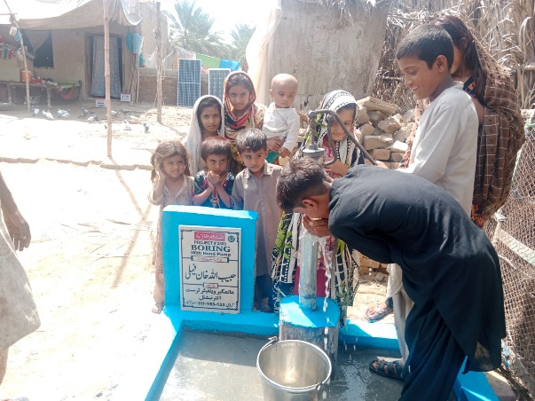
HAND PUMPS:
85 hand pumps worth of Rs. 2,125,000/- were installed, in collaboration with Alamgir Welfare Trust International, to help in supply of water among poor families residing in Mityari, Larkana, Khairpur and Mirpur Khas.
Also installed two hand pumps of worth Rs.100, 000 /- in collaboration with RDF, in village of Tando Adam, District Sanghar. This initiative has brought clean and accessible water to community in need.
Allah says in Quran “Indeed, the men who practice charity and the women who practice charity and [they who] have loaned Allah a goodly loan – it will be multiplied for them, and they will have a noble reward.”- [57:18]

Slide 17

WINTER DRIVE:
Blankets were distributed among underprivileged families in Karachi, TandoAllahyar-Sindh, Tando Adam-Sindh, Village of Goundariro District Khairpur-Sindh, Larkana-Sindh, Sukkur-Sindh, Hyderabad-Sindh,Sujawal-Sindh, Peshawar-KPK, Quetta-Baluchistan, Kalam-KPK, Abbottabad-KPK and Nathiagali-KPK.
Welfare institutes in Karachi, like DarulSukun Kashmir Road,DarulSukun Old House,Idarieu School for blind and deaf, Aashiyana Trust and Abbasi Shaheed Hospital, received and distributed the warm blankets.
Blankets and Jackets were sent to NGO Aabroo Educational Welfare Organization in Lahore, and were distributed among underprivileged families in Punjab.
Poor students of People’s School Mirpur Batholo District Sujawal and Badin Madressah received jackets. Furthermore, jackets were distributed among children in Peshawar-KPK, Larkana-Sindh,Kalam-KPK and Nathiagali-KPK.
Distributed shoes and socks among children in Peshawar-KPK, Lahore-Punjab, Kalam-KPK and Abbottabad-KPK.
Shawls distributed at DarulSukun Old House M.A Jinnah Road and TandoAllahyar.
Received in-kind donation of 283 coats, having cost of Rs.283, 000/-and distributed among needy individuals in Abbotabad, Disable Centre Peshawar, Kalaam, Bajour and Nathiagali KPK.
This winter, Syed Foundation successfully contributed to providing warmth and comfort to those in need by distributing blankets, jackets, coats, shawls, shoes and socks worth of Rs. 1,883,250/-

Slide 18
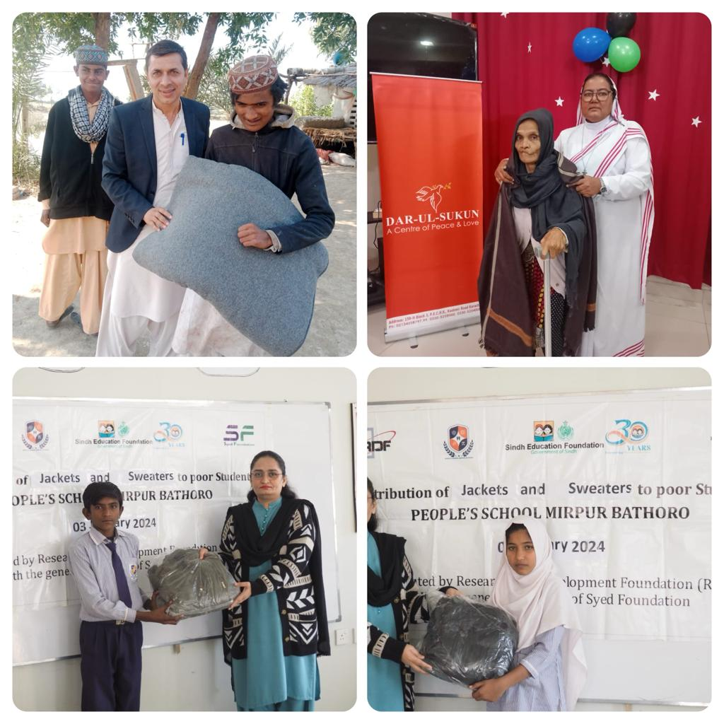
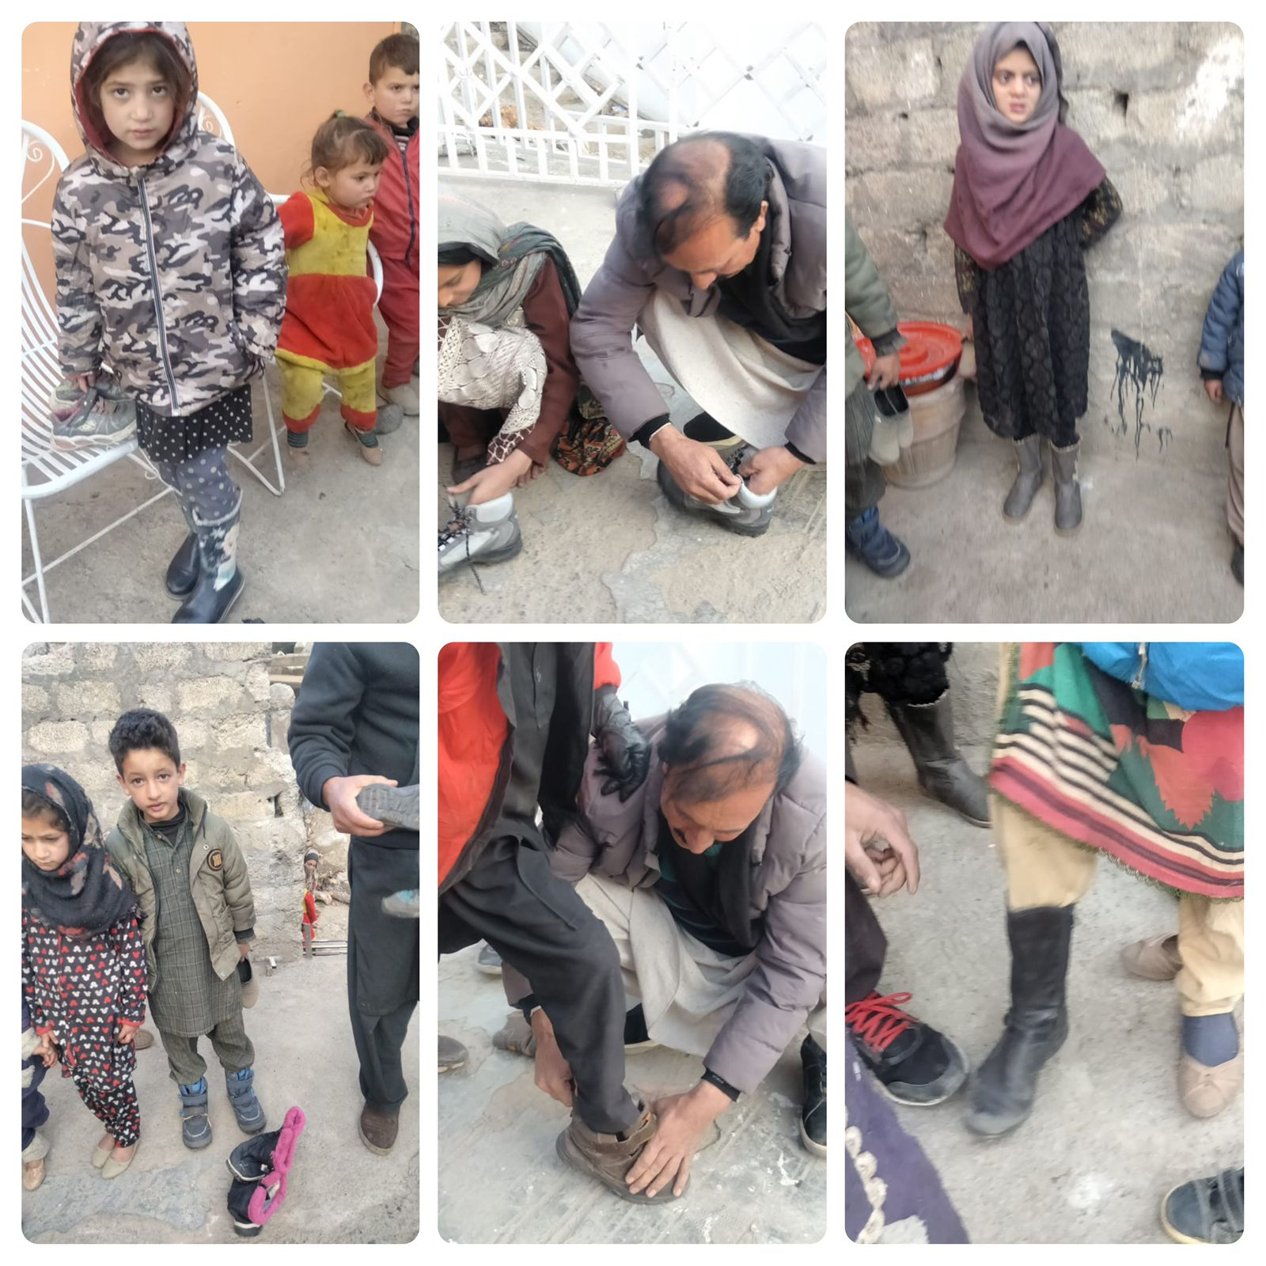

Slide 19
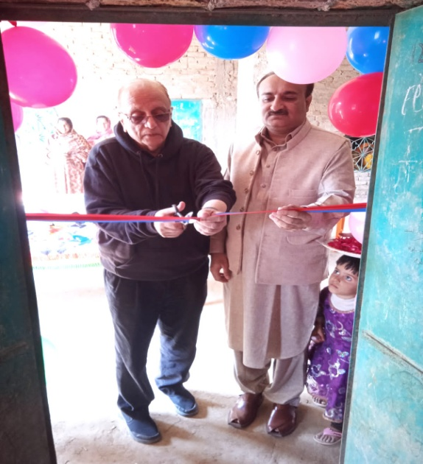

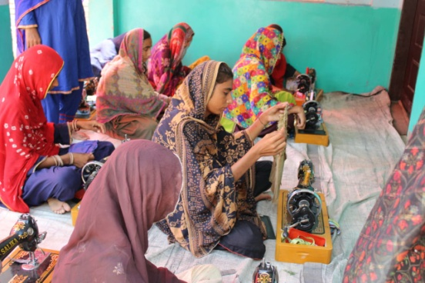
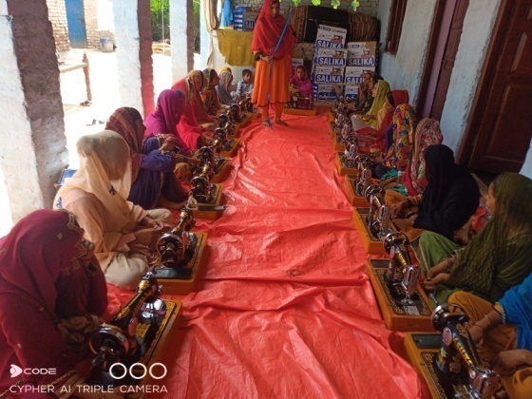
TRAINING INSTITUTE FOR STITCHING:
The stitching center has been established in Tando Allah Yar, Sindh, in collaboration with Research & Development Foundation.
The women are given training, after which they will be provided with an interest-free loan to start their business.
The seed money for the loan scheme is 1.5 million rupees.

Slide 20
PROJECT WITH RDF:
Inaugurated the second batch of stitching center at Malook Khan, a village near Tando Allahyaar.
To combat the winter chill, blankets and shawls were distributed among the needy individuals at the stitching center and throughout Hyderabad, providing warmth and comfort during the colder months.
President of Syed Foundation presented a memento to the Executive Director of RDF Mr.Ashfaque Ahmed Soomro, reinforcing the spirit of solidarity and joint commitment.

Slide 21

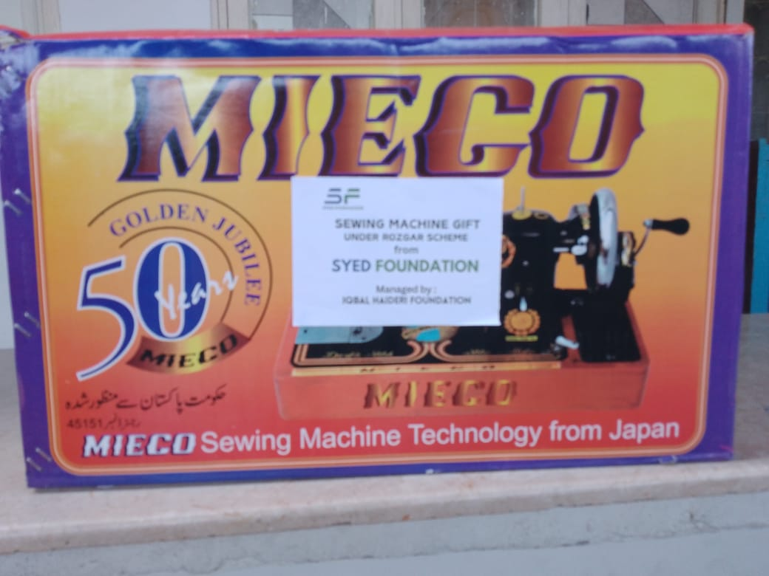
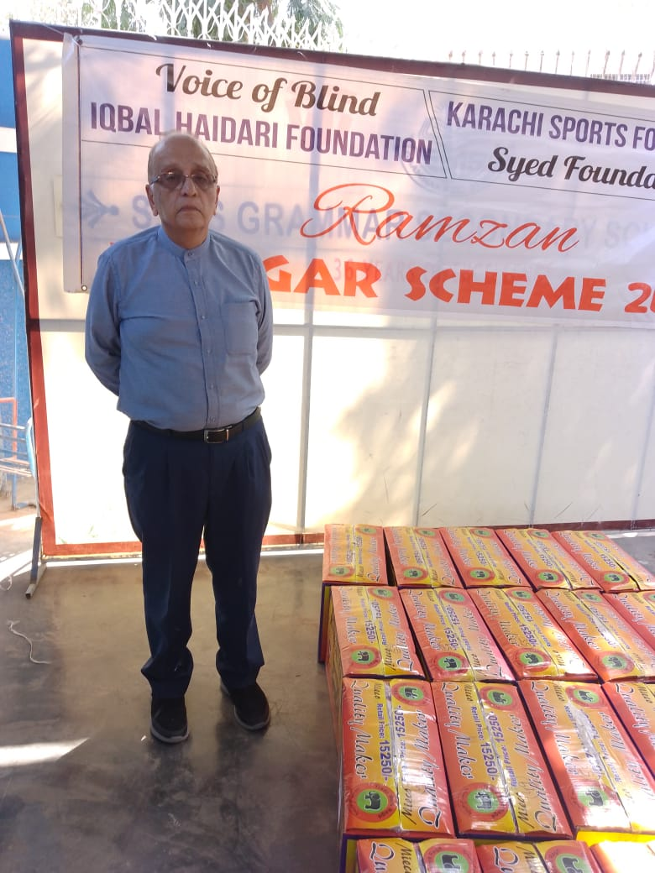
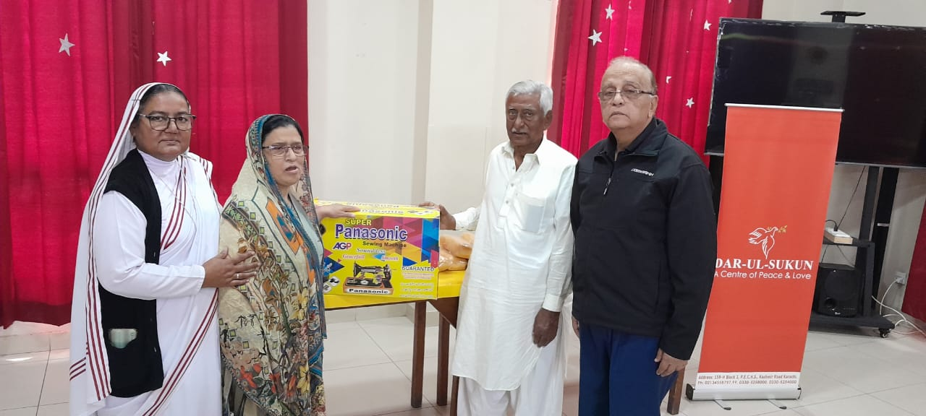
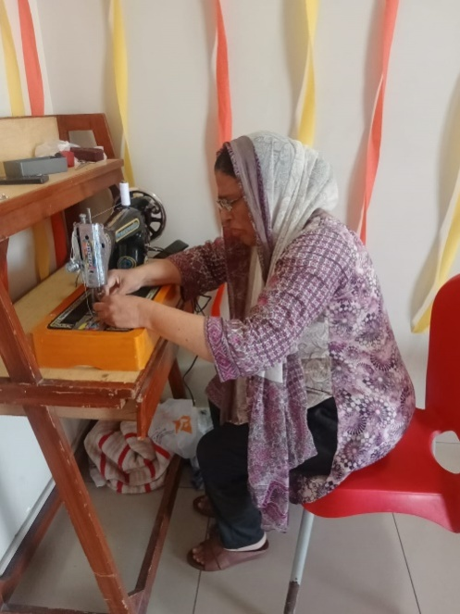
SEWING MACHINE:
Supplied a sewing machine of worth Rs.10,200/- to Darul Sukun Old House.
Directly Distributed sewing machines to deserving underpriviliged individuals in Karachi including maids and tailors.
In collaboration with Iqbal Haidri Foundation 10 machines were donated to deserving individual with the aim to provide the means to generate income and achieve self-empowerment.

Slide 22
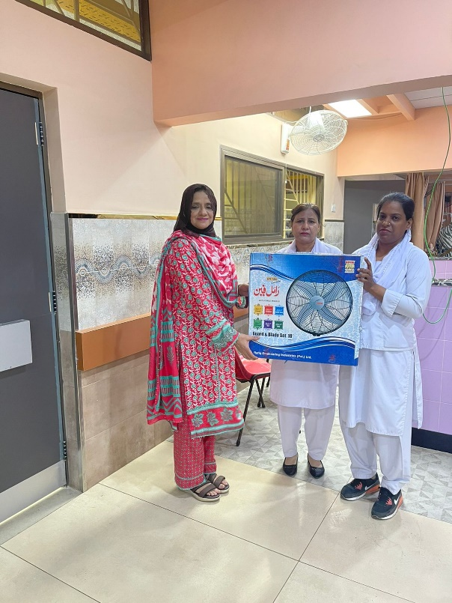
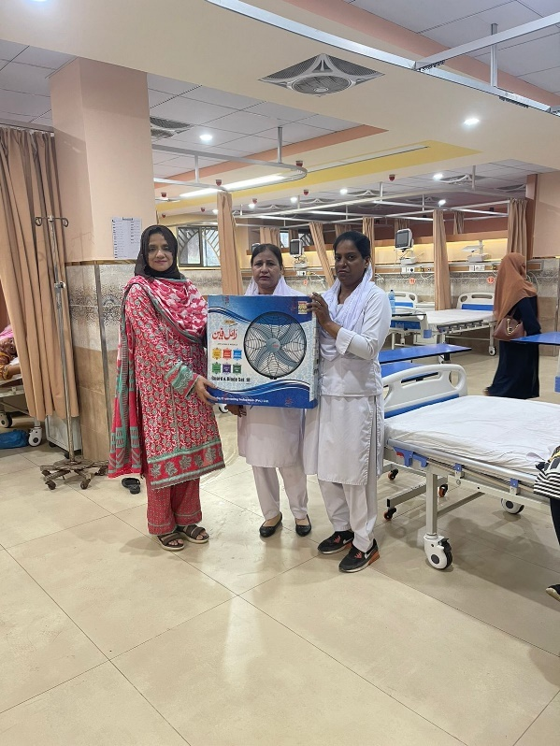
ABBASI SHAHEED HOSPITAL
Donated seven bracket wall fans for the Gynecology ward of Abbasi Shaheed Hospital, ensuring that both patients and staff can stay comfortable during the hot summer season.

Slide 23
BEDSHEETS:
Donated 100 bedsheets to orphanage Sweet Home Hyderabad, 150 bedsheets to the elderly care home DarulSukun Old House Karachi and 25 bedsheets to Gynaecology Ward of Abbasi Shaheed Hospital worth of Rs.220,000/- , aiming to provide comfort and warmth to residents in need.
CHARITY EVENT
The orphanage, Al-Furqan Homes, conducted a heartwarming charity event where the children showcased their talents in a vibrant talent show, and we contributed a donation of Rs. 2,000/- to support the event.

Slide 24

Prophet Muhammad (SallallahuAlaihiWasallam) Said:
“Sadaqah wipes out sins like water extinguishes fire.” – [Tirmidhi]
SADQAH:
Syed Foundation provides service of doing Sadqah in form of slaughtering of animal or provision of grocery bags.This year 28 goats have been slaughtered, and the meat was distributed to poor people.
SADQAH-E-JARIAH:
Contributed Rs. 120,000/- in construction of a Masjid-e-Ibrahim at Scheme 33, Karachi .
Provided ten stools to enhance seating facilities at the orphanage Sweet Home,Hyderabad.
Undertook the installation of a solar panel in a Masjid. The total Cost for its installation was Rs. 175,000/-.

Slide 25
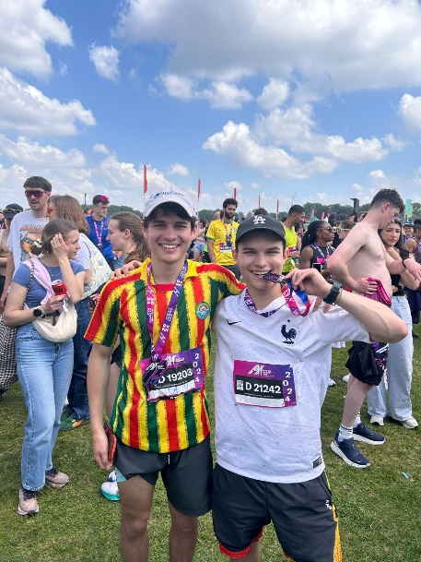
15. BAKRA EID IJTAMAE QURBANI
We conducted Ijtamae Qurbani in collaboration with Alamgir Welfare Trust International, contributing 15 shares of cow and 5 goats. Total worth of this project was Rs. 444,150/- The meat was distributed among needy families in Karachi and Baluchistan.
16. SHIELD DISTRIBUTION:
In recognition of the invaluable contributions of our donors and the dedication of our team members, Syed Foundation distributed shields to express our gratitude. This gesture symbolizes our appreciation for their unwavering support and commitment to our cause.
17. YOUNG PHILANTHROPIST:
Axel Syed and Liam Syed, the young boys with the passion to serve the humanity particularly for the women empowerment project organized a fundraiser in the UK wherein people around the globe contributed and the amount raised shall be used in the Women Empowerment Project. Through which multiple under privileged women will learn hand embroidery and other such crafts. Thereafter we shall provide them with interest free loan to encourage entrepreneurship so that they can begin their own businesses from the comfort of their homes which leads towards sustainable solutions for unemployment and poverty.

Slide 26
HUMANITARIAN AID TO GAZA
TOTAL DONATION: RS.11,999,110/-

Slide 27

First Phase (November)
During the first phase of the Palestine Aid Project cycle , in collaboration with Alamgir Welfare Trust International and 70F Friends and Humanity, our significant contributions included Blankets and Medical Supplies worth of Rs. 6,478,444/-.
Second Phase
(April)
In the second phase of our donation cycle,in collaboration with 70F Friends of Humanity, we focused on food security and donated Rice and Ready-made Food worth of Rs. 2,000,000/-
Third Phase (June)
In partnership with 70-F Friends of Humanity and Idara-e-Akhwan-us-Sadat Gulaothvi, the third phase involved a diverse range of donations amounting to Rs. 2,200,666/- including 3052 packets of ready-made food , 46 packets of 250gm and 108 packets of 1kg of wheat porridge, 1000 kg rice, 162 abayas , essential medicines and 150 footballs .
QURBANI
In celebration of BakraEid, conducted qurbani in collaboration of Al-Khidmat Foundation, amounting to Rs.1,320,000/-, comprising 29 shares of cows and two goats. The qurbani meat will be cooked, packed in tin containers, and sent to our Gaza families.

Slide 28
RAMADAN PROJECT

Slide 29
This year, our Ramadan Project reached new heights having the total worth of Rs.23,580,000/- . With help of our donors, Syed Foundation was able to meet needs of people at our full capacity. We catered 8,672 people for Iftar-Dinner and distributed following things:
S.NO | ITEMS | QUANTITY | COST
1. | Grocery Bags | 1,833 | Rs. 11,230,000
2. | Flour | 37,172 kg | Rs. 5,386,900
3. | Rice | 60 kg | Rs. 12,500
4. | Dates | 112 Kg | Rs. 128,000
5. | Rooh-Afza | 186 bottles | Rs. 74,400
6. | Vegetables | 75 bags | Rs. 36,000
7. | Oil | 992 | Rs. 446,400
8. | Eid clothes | 200 Gents 206 Ladies | Rs.479,750

Slide 30
IFTAR DINNER
We catered 8,947 people for Iftar-Dinner across Pakistan and spent Rs.1,660,836/- .
Iftaar drives were conducted at Karachi, Tharparkar, TandoAllahyaar, TandoAdam,Sujawal, orphanage Sweet Home Hyderabad, Mirpurkhaas, Sanghar, orphanage Aabroo Homes Lahore, Kasur, Bhawalpur, Thal Hyderabad, Abotabad, Gilgit, Bajour Agency, Quetta and BaghNadi Baluchistan.
FIDYA:
In response to the generous contribution of Rs. 137,415/- received as FIDYA from our donors, a decision was made to allocate this amount to Alamgir Welfare Trust International, used to procure ration bags for distribution among needy individuals.
FITRA:
We've received Rs.86,000/- from our compassionate donors as Fitra. These contributions have been pivotal in facilitating our Iftaar/dinner program, providing sustenance to those in need during the sacred month of Ramadan.
EID CLOTHES:
In celebration of Eid and as part of our commitment to supporting deserving individuals, a distribution initiative for Eid clothes was undertaken bring joy and celebration to deserving individuals and families.

Slide 31
EVENTS
AND
CELEBRATIONS

Slide 32
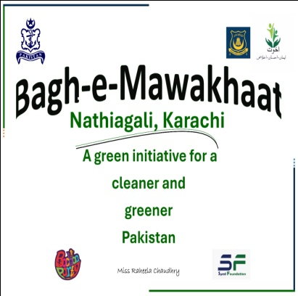
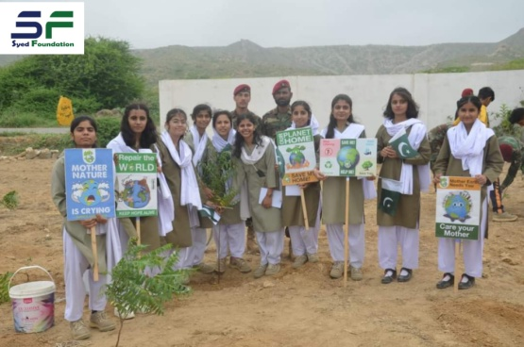
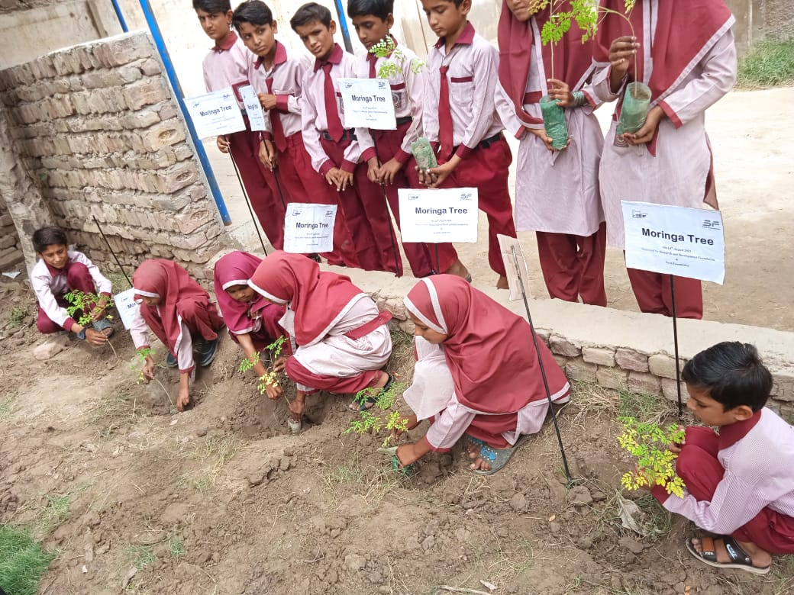
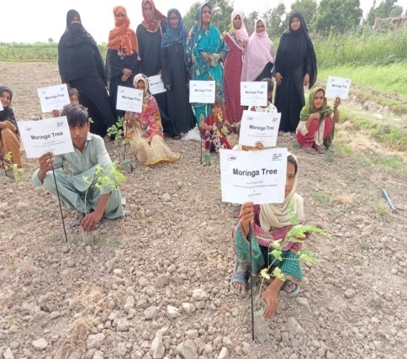
Independence Day and Tree Plantation Drive:
On the occasion of Pakistan's 76th Independence Day, Syed Foundation took the initiative of planting trees in collaboration with RDF in TandoAllahYar and NJV School (adopted by Akhuwat Foundation) in Nathiagali, Karachi.
350 plants of diverse variety were planted, paving the way for sustainable environment.

Slide 33

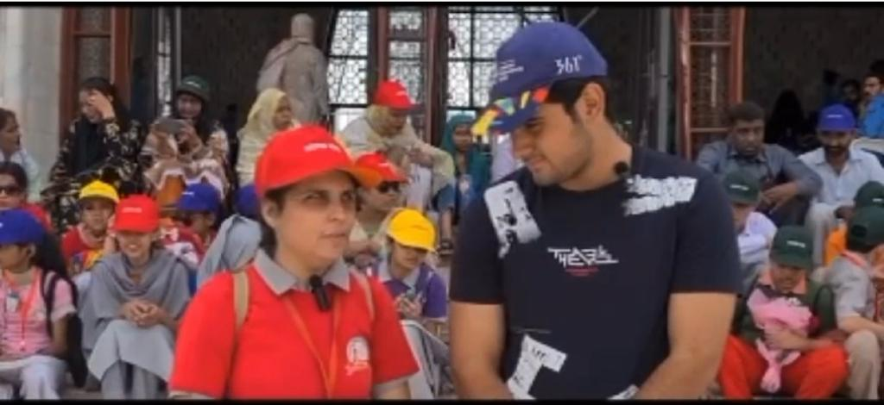
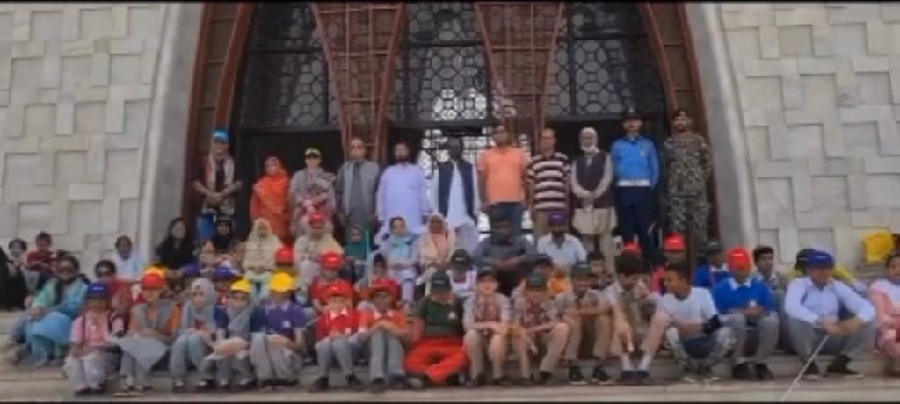
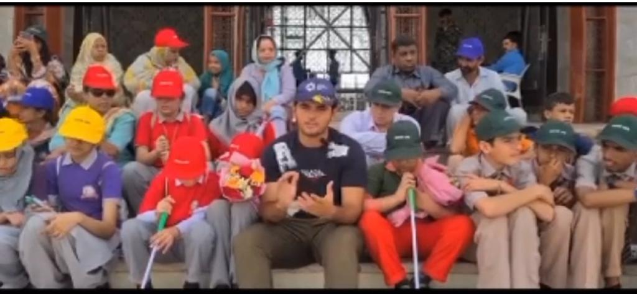
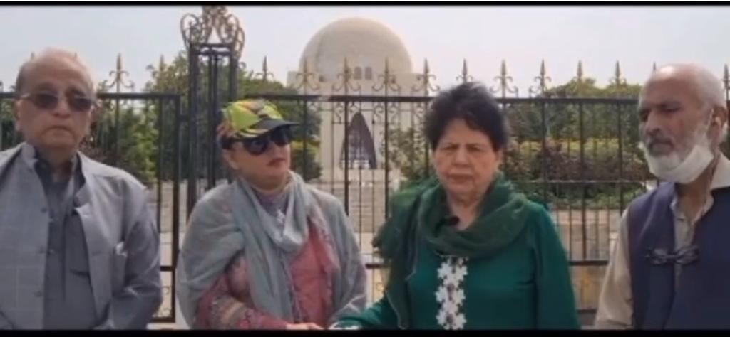
White Cane Day:
White Cane Safety Day, observed on October 15th, promotes understanding and respect for those with visual impairments, fostering a more inclusive society that recognizes and supports the autonomy of individuals with blindness.
Syed Foundation in collaboration with Voice of Blind and Silver line school celebrated White cane day on 15th October at Mazar-e-Quaid, where juices and water bottles were distributed among blind children.

Slide 34

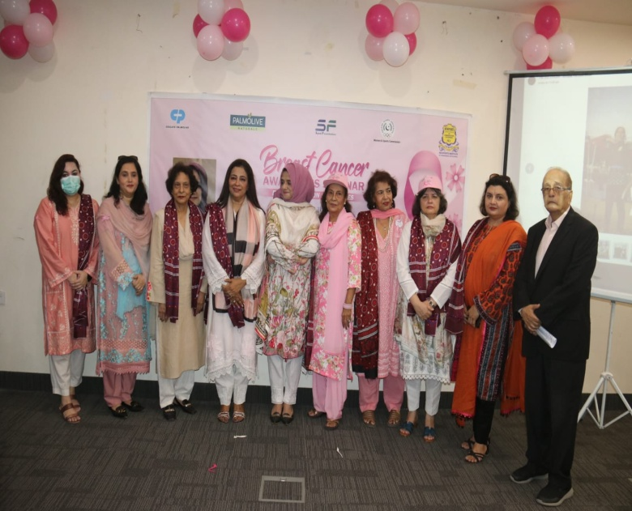
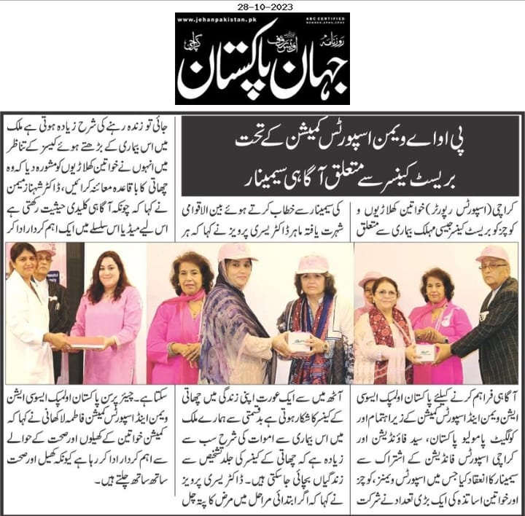
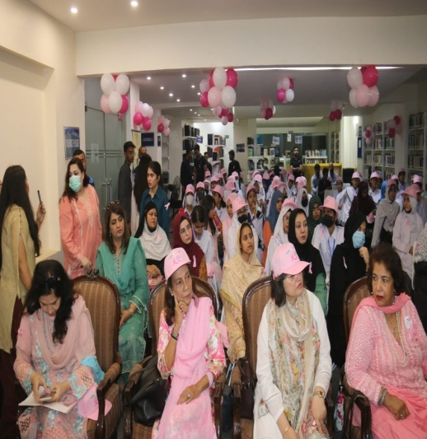
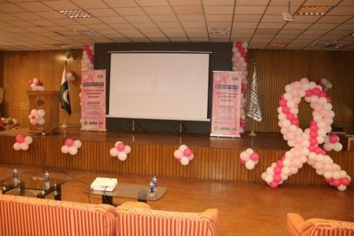
Seminar of Breast Cancer Awareness:
Syed Foundation conducted three sessionst o give information about early diagnosis, treatment and prevention.
FBR by Dr.RufinaSoomro, FCPS, FRCS, FACS, Professor, Department of General Surgery on 15th October 2023.
Sindh Madrasatul Islam University by Dr. UsraPervaiz, Assistant Professor, Breast Surgical Oncologist, SIUT, on 25th October 2023.
New Port Institute of Communications and Economics by Dr. ShabnamShamimAsim, Professor and Consultant, Department of Gynecology& Obstetrics, Karachi Medical and Dental College and Abbasi Shaheed Hospital, on 28th October 2023.

Slide 35
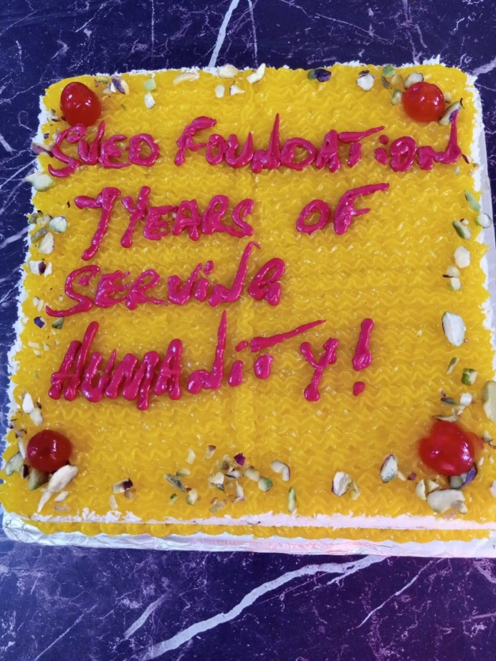
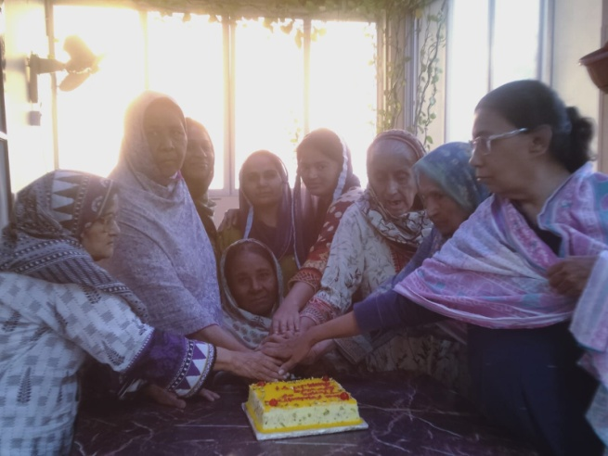
Anniversary Celebration of Syed Foundation:
The month of November marks the beginning of Syed Foundation. The anniversary was celebrated by distributing eatables at Aashiyana Trust Old House, DarulSukun Old House M.A Jinnah Road, DarulSukun Kashmir Road, Magnanimous school Orangi Town and Idarieu School for blind and deaf.

Slide 36
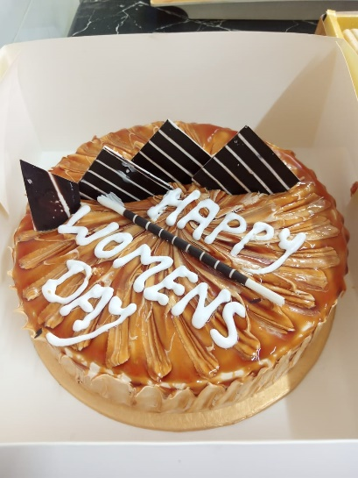
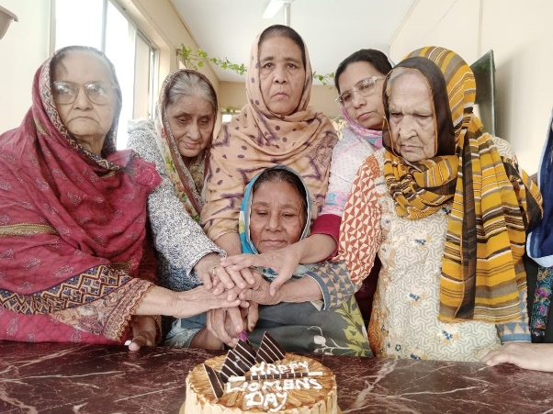
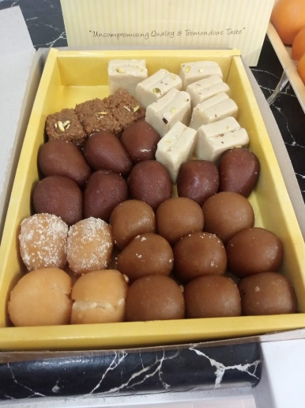

LABOR DAY:
On Labor Day, we honored the hardworking individuals by distributing fruits among the staff members of institutes including Aashiyana Trust old house for women, Idarieu School for blind, Darul Sukun Old house and Darul Sukun Institute for disable children.
SINDH GAMES:
The 18th Sindh Games were conducted in Karachi from February 23-26 at various sports centre in the city. This year’s games saw participation from over 4,000 athletes hailing from Karachi, Hyderabad, Sukkur, Mirpurkhas, Larkana, and Benazirabad. During the event, Syed Foundation played a significant role by distributing food, souvenirs, T-Shirts, food vouchers and gifts among the players of Boxing, Softball ,Judo and MMA, contributing to the success and spirit of the games.
WOMEN DAY:
Celebrated Women Day with the ladies residing at Aashiyana Old House for women.

Slide 37



EID CELEBRATION:
On 14th April, Syed Foundation had the honor of celebrating Eid with disabled children at the DarulSukun Institute.
A delectable Eid feast, featuring biryani, jalebi, ice cream, and refreshing drinks, delighted the senses and added to the festive ambiance.
The Eid celebration at DarulSukun Institute provided a meaningful experience for the disabled children, allowing them to partake in the joyous occasion alongside their peers

Slide 38




BAKRA EID CELEBRATION:
We had the honor of celebrating Eid with disabled children at the DarulSukun Institute.
A delectable Eid feast, featuring Kabab Paratha, ice cream, and refreshing drinks, delighted the senses and added to the festive ambiance.
TheEid celebration at DarulSukun Institute provided a meaningful experience for the disabled children, allowing them to partake in the joyous occasion alongside their peers.

Slide 39

CONCLUSION:
Since its formation, Syed Foundation has been working effortlessly for the betterment of people. Being aware of all the local problems and challenges faced by people, the main focus is on development, empowerment, help, and turning the poor and underprivileged citizens into champions by contributing in making life for them.
As quoted my Maya Angelou;
“Try to be a rainbow in someone else’s cloud”

Slide 40


THE TRADEMARKS REGISTRY

Slide 41

FBR CERTIFICATE

Slide 42


OUR FELLOW PHILANTHROPIST (STARS OF OUR GALAXY)

Slide 43

OUR CORPORATE SPONSORS

Slide 44


Slide 45
THANKYOU

